Slide 1
How to Complete a Provider Enrollment Application
FACILITY PROVIDER
Begin

Slide 2


How to Complete a Provider Enrollment Application
The Purpose of the Enrollment Application
How to Complete an Application for a Facility
What Types of Credentials are Required
How to submit your Provider Enrollment Application
Next

Slide 3

Completing an Enrollment Application
Provider Enrollment Form - U.S. Department of Labor
All practice types (Individual/Facility/Group), must complete this section of the application.
Provider Enrollment Form
Please refer to instructions for completing this form.
U.S. Department of Labor
Office of Workers’ Compensation Programs
OMB Number 1240-0021
Expires: 1/31/2013
Provider Number | Effective Date
FOR DOL USE ONLY
1. Are you applying for a new enrollment or updating your record? New enrollment Update If update, enter Provider Number or Employer Identification Number (EIN): |  | 1a. Program FECA Black Lung Energy
999909999
Block 1: Indicate whether this form is being used for a new enrollment, or to update an *
existing enrollment record.
Note: If the form is being submitted to update your record, enter your Provider Number or Employer Identification Number.
Block 1a: Check the program in which you want to enroll as a provider. *
Note: If the provider wants to enroll in additional programs, a separate application is required for each program
* If data is missing from these fields, the application will be Returned to the Provider (RTP)
Next

Slide 4
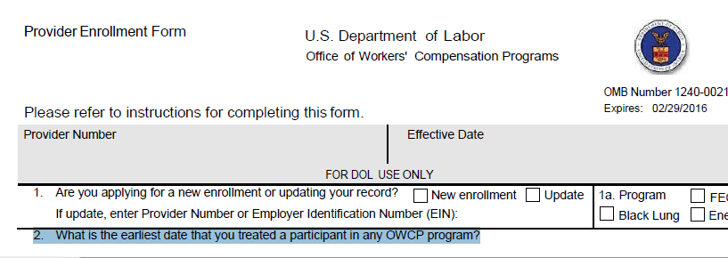
Completing an Enrollment Application
Ex. 2/22/2015
Block 2: Indicate earliest date you treated any OWCP beneficiary.
Next

Slide 5
Completing an Enrollment Application
Provider Enrollment Form - U.S. Department of Labor
Practice Information (Section 3)
All practice types (Individual/Facility/Group), must complete this section of the application.
Provider Company Inc
4090 Corporate Street
Corporate Town
FL
51551
999-999-9999
999-999-9999
Corporate0x@Corp.Com
Box 3: The provider should type/print their practice name
Box 4: The provider should type/print their practice physical address (P.O. Box is not acceptable - RTP)
Box 5: The provider should type/print their practice city
Box 6: The provider should type/print their practice state
Box 7: The provider should type/print their zip code (all 9-digits)
Box 8: The provider should type/print their practice phone number
(Note: if the provider submits a cell phone # for the practice, the provider must submit a copy
of their cell phone bill. The address on the bill MUST match the address in box 4)
* If data is missing from any of these fields, the application will be Returned to the Provider (RTP)
Next

Slide 6


Completing an Enrollment Application
Provider Enrollment Form - U.S. Department of Labor
Providers MUST Select a Type of Practice
Next

Slide 7

Completing an Enrollment Application
Provider Enrollment Form - U.S. Department of Labor
If the provider checked “b” for facility, they must complete boxes 11a through 12. *If data is missing from these fields, the application will be Returned to the Provider (RTP)
Provider Type (Individual or Facility) (Please see attached listing)
11a. Provider Type Code | 11b. Provider Type Description (see attachment)
11c. If you select "Other Provider" (96) or Non-Medical Vendor (53), please explain:
12. Tax ID: (EIN or SSN)
Block 11a: The provider should type or print their “provider type.” (A list of provider
types are attached to the application) *
Block 11b: The provider should type or print the description of the provider type
selected in box 11a.
Block 11c: If the provider is an individual, and selected a provider type of either (96) – Other Provider, or
(53) – Non Medical Vendor, the provider must type or print an explanation and a description of
The services that will be performed. *
Block 12: The provider should type or print their SSN or EIN as appropriate. *
Note: If the provider is a sole proprietor they should use their SSN #
If the provider is an LLC, INC, etc., they should use their EIN #
* If data is missing from these fields, the application will be Returned to the Provider (RTP)
Next

Slide 8

Completing an Enrollment Application
Provider Enrollment Form - U.S. Department of Labor
If the provider checked “b” for facility, they must complete boxes 13a through 13c.
FOR HOSPITALS ONLY
Box 13a: The facility must type/print the Medicare number *
Box 13b: The facility must type/print their National Provider Identifier (NPI) number *
(Note: the provider can use as many lines as needed)
Box 13c: The facility must type/print all applicable taxonomy codes *
* If data is missing from these fields, the application will be Returned to the Provider (RTP)
Next

Slide 9
Completing Enrollment Application
Provider Enrollment Form - U.S. Department of Labor
If the provider checked “b” for facility, they musty complexes 16a through 18. *The provider MUST sign and date the enrollment application or it will be returned to provider and will NOT be processed
Same
16b. City 16c. State 16d. Zip (9 digits)
17. I have completed a ACH Vendor Payment/Electronic Funds Transfer (EFT) form.
18. I am interested in billing electronically (check one): P2P Link EDI Web Submission
Coral Jakes, MD
1/24/2016
Box 15: This box is only for Black Lung providers who have a UMWA Health & retirement Fund member #
Box 16a: The provider should type/print address where they want the Remittance Advice to be sent
Box 16b: The provider should type/print billing city if this is different from block # 5
Box 16c: The provider should type/print billing state if this is different from block # 6
Box 16d: The provider should type/print billing zip code (all nine digits), if this is different from block # 7
Box 17: The provider should check this box to indicate they have completed an ACH Vendor Payment
Box 18: If the provider is interested in electronic billing they should check one of the 3 methods
Signature/date: The provider MUST sign and date the enrollment application *
Next

Slide 10


Submitting an Enrollment Application
Provider Enrollment Form - U.S. Department of Labor
Once the enrollment application is completed, the provider will mail the application to the appropriate program shown below. The completed enrollment form must be accompanied by a completed ACH Vendor Payment Information Form or it will be returned to the provider.
For Federal Employees’ Compensation Act (FECA) Program | For Black Lung Program | For Energy Program
OWCP/FECA P.O. Box 8300 London, KY 40742-8300 | DCMWC/Black Lung P.O. Box 8302 London, KY 40742-8302 | DEEOIC P.O. Box 8304 London, KY 40742-8304
If you have any questions regarding the completion of the form, please call Toll Free: 1-844-493-1966 | If you have any questions regarding the completion of the form, please call Toll Free: 1-800-638-7202 | If you have any questions regarding the completion of the form, please call Toll Free: 1-866-272-2682
How to Complete the ACH Vendor Payment Form
Exit

