Slide 1
How to Complete a Payment Information Form
ACH Vendor
Payment System

Slide 2


Table of Contents
How to Complete the Payment Information Form – ACH Vendor Payment System
Federal Regulation Requirements
Medical Provider Information
Agency Information (Federal Agencies)
Financial Institution Information

Slide 3
Automated Clearing House (ACH) Vendor Payment Form
ACH Form Requirements
Effective March 1, 2013:
As part of the OWCPs compliance with federal regulation 31 C.F.R Part 208, all providers that enroll in a U.S. Department of Labor Office of Workers’ Compensation Program must use electronic fund transfer (EFT) as the method of payment.
The ACH form included as part of the enrollment packet must be submitted with the enrollment application. Failure to submit a completed ACH form with a completed enrollment application will result in the form being Returned to Provider (RTP)
The ACH form is a Department of Treasury form (SF form 3881); used in compliance with the federal mandate referenced above.
The ACH form must be fully completed. Failure to complete the form will result in the enrollment application being Returned to the Provider (RTP).

Slide 4
Automated Clearing House (ACH) Vendor Payment Form
*Section # 1
Section # 2
*Section # 3
*If data is missing from these fields, the application will be Returned to the Provider (RTP)

Slide 5
Automated Clearing House (ACH) Vendor Payment Form
Section # 1
MEDICAL PROVIDER INFORMATION
Provider #:
Name:
Address:
Contact Person Name: Telephone Number:
Aux Corporation
9th Clearing Vendor Street
Aux Vendor, HV 99999
Chase Vendor
999-999-9999

Slide 6
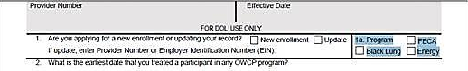

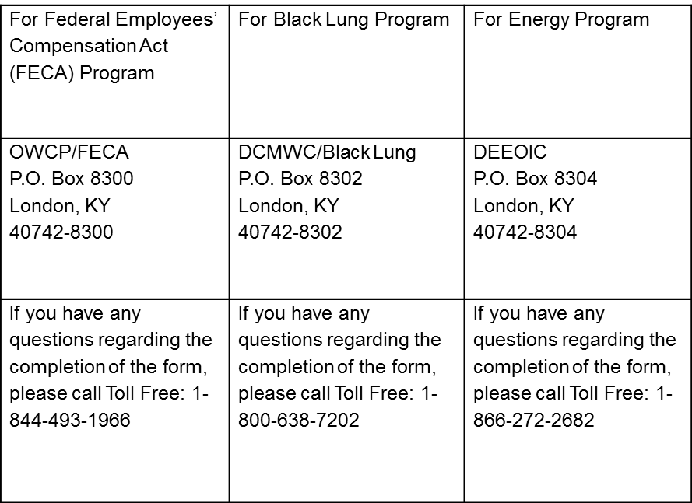
Automated Clearing House (ACH) Vendor Payment Form
Section # 2
AGENCY INFORMATION
Name:
Address:
Contact Person Name: Telephone Number:
Federal Employee Compensation Act
P. O. Box 8300
London, KY 40742-8300
Section # 2: Should be completed by the Federal Agency Name: The provider should type/print the name of the federal agency making the payment (ex. FECA) Address: The provider should type/print the P.O. Box for the federal agency (ex. FECA = P.O. Box 8300) Contact: This field can be left blank Number: This field can be left blank

Slide 7
Automated Clearing House (ACH) Vendor Payment Form
Section # 3
FINANCIAL INSTITUTION INFORMATION
Name:
Address:
ACH Coordinator Name: | Telephone Number:
Nine-Digit Routing Transit Number:
Depositor Account Title:
Depositor Account Number:
Type of Account: □ Checking □ Savings
Signature and Title of Representative: | Telephone Number:
Section # 3 Should be completed by the financial institution FI
Name: Type/print the name of the FI (Bank)
Address: Type/print the address of the FI (Bank)
ACH Coordinator Name: Type/print the name of the FI coordinator
Number: Type/print the phone number of the FI coordinator
Routing: Type/print the 9-digit routing transaction number (TRN)
(Note: if the FI uses a processor, the TRN of the FI should be used
Depositor Acct. #: Type/print the number of the account where funds are to be deposited
Type of Acct.: Check the type of bank account the funds will be going to. Checking or Savings account
Signature/title: The Financial Institution’s representative must sign the form
Number: Type/print the telephone number of the Financial Institution’s representative

Slide 8

For more assistance, please contact a customer service representative Monday-Friday
8am-8pm EST. @ options 4 & 2.
844-493-1966

